Slide 1
Sentiment Analysis
Let’s Begin !!!

Slide 2
Team Members :
20BCY10186
(B. SHIVA SAI)
20BCY10176 (CH. SAI MANEESH)
20BCY10102 (G. SHARAN RAGHAV)
20BCY10087 (Ashutosh Shukla)
Guide :
Dr. Ashish Ranjan Sir

Slide 3
Sentiment analysis is the process of detecting positive or negative sentiment in text. It’s often used by businesses to detect sentiment in social data, gauge brand reputation, and understand customers. Since customers express their thoughts and feelings more openly than ever before, sentiment analysis is becoming an essential tool to monitor and understand that sentiment. Automatically analyzing customer feedback, such as opinions in survey responses and social media conversations, allows brands to learn what makes customers happy or frustrated, so that they can tailor products and services to meet their customers’ needs.
Introduction :

Slide 4
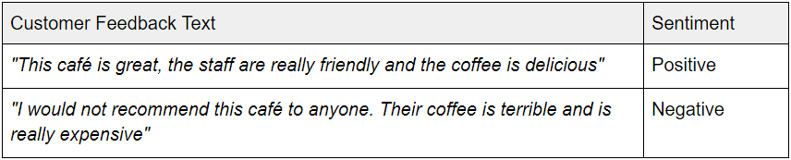
For example in customer feedback:
Introduction :

Slide 5
Objective / Problem Statement :
Objective Statement :-
By using sentiment analysis, you gauge how customers feel about different areas of your business without having to read thousands of customer comments at once.
If you have thousands of feedback per month, it is impossible for one person to read all of these responses. By using sentiment analysis and automating this process, you can easily drill down into different customer segments of your business and get a better understanding of sentiment in these segments.
Problem Statement :-
While sentiment analysis is useful, it is not a complete replacement for reading survey responses. Often, there are useful nuances in the comments themselves. Where sentiment analysis can help you further is by identifying which of these comments you should read.

Slide 6
Literature Review :
The comparison of two politicians was made on the basis of real-time Twitter data , extracted from Twitter by using Twitter-streaming application programming interface (API) .
Two sentiment analyzers named SentiWordNet and WordNet were used to find positive and negative scores.
To add accuracy to the model, negation handling and word sequence disambiguation (WSD) were used .
Twitter streaming API was also used to gather data by the authors of for the prediction of the Indonesian presidential elections. The aim was to use Twitter data to understand public opinion.
For this purpose, after the collection of data, the study performed automatic buzzer detection to remove unnecessary tweets and then analyzed the tweets sentimentally by breaking each tweet into several sub-tweets. After that, it calculated sentiment polarity and, to predict election outcome, used positive tweets associated with each candidate, and then used mean absolute error (MAE) in order to measure the performance of the prediction and make the claim that this Twitter-based prediction was 0.61% better than the same type of surveys conducted traditionally.

Slide 7
Proposed Work :
To forecast a Swedish election outcome, other than sentiment analysis a link structure was analyzed using Twitter involving politicians’ conversations.
For this purpose, this used a link-prediction algorithm and showed that account popularity known by structural links have more similarities with outcomes of the vote.
This also revealed that there is a strong dependence between the standing of selected politicians and the outcome of the general election and also of the official party account and European election outcome. A methodology was created to test Brazilian municipal elections in 6 cities .
In this methodology, sentiment analysis was taken into consideration along with a stratified sample of users in order to compare the characteristics of the findings with actual voters.
As the sentiment analysis of tweets has gained popularity in recent years, the sentiments of queries generated by users has been calculated by page-rank algorithms and the Naïve Bayes classifier. For the prediction of the 2016 US elections, manually annotated corpus-based hashtags along with negation detection were tested and a claim was made that a 7% accuracy level had increased. The model adopted to rank the candidates of political parties included the lexicon-based approach and the linguistic inquiry word count (LIWC)

Slide 8
Real time usage :
Social media monitoring
Customer support management
Analyzing customer feedback
Brand monitoring and reputation management
Voice of customer (VoC)
Voice of employee
Product analysis
Market research and competitive research
Track the perception of the brand by the customers

Slide 9
Hardware & software requirements
Hardware Requirements :-
Basic laptop system and no other hardware requirements
Software Requirements :-
Linux Operating System/Windows
Python Platform(Anaconda 2 , Spyder , Jupyter)
NLTK package
Modern Web Browser
Twitter API, Google API

Slide 10
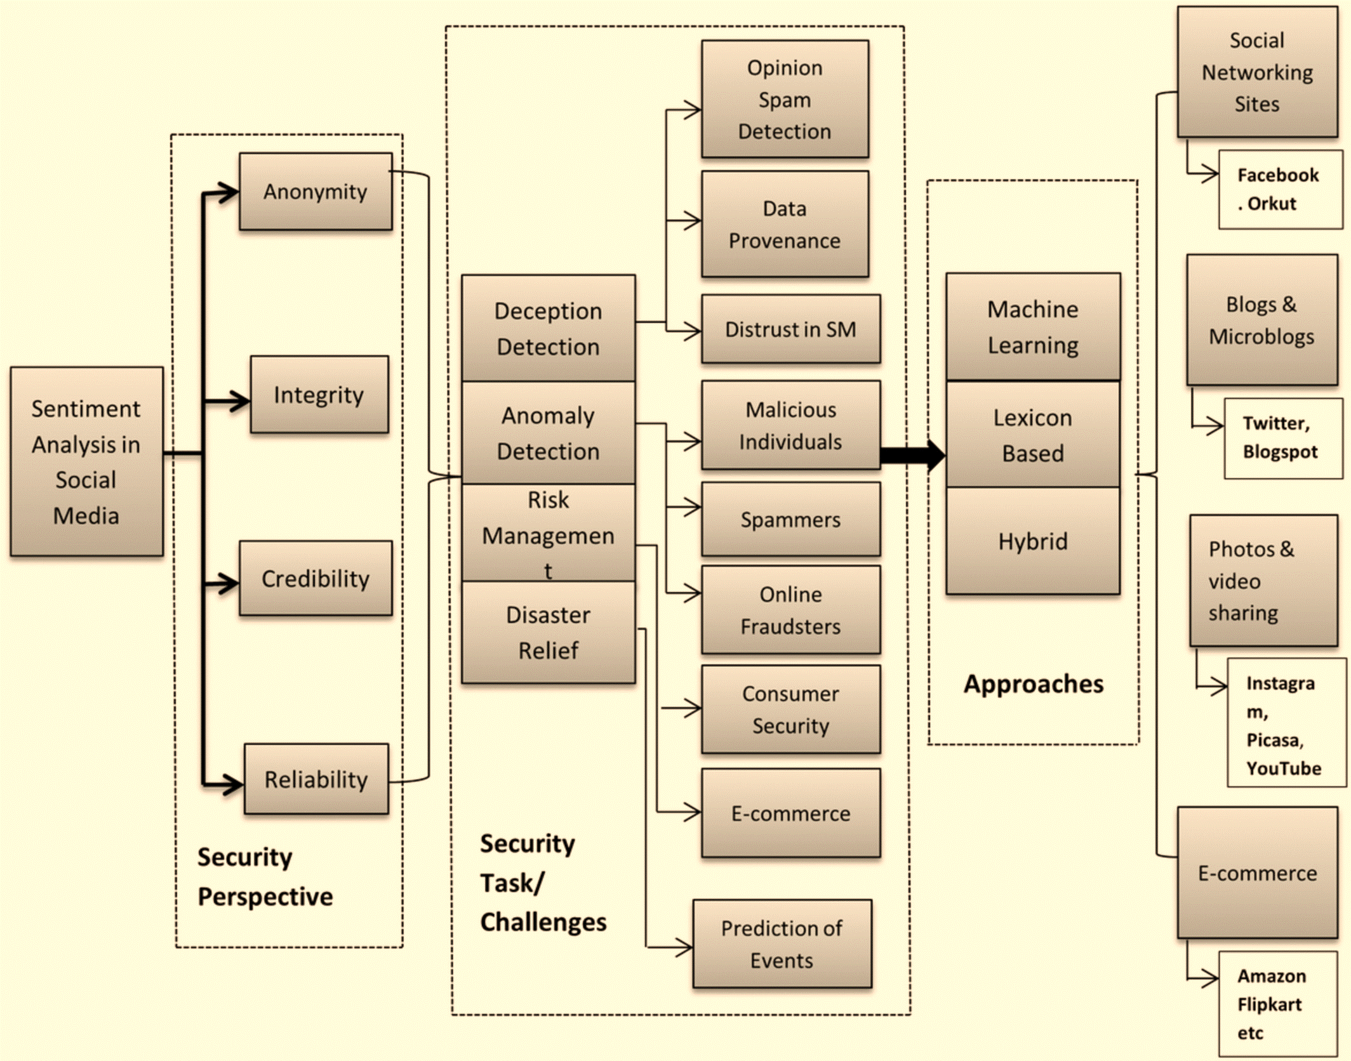
Overall System Architecture Diagram

